Slide 1



TEAM NAME- PROJECT SAMARTH KRUSHAK
COLLEGE NAME- VEER SURENDRA SAI UNIVERSITY OF TECHNOLOGY
© 2024 Cognizant

Slide 2

Ideation Submission - Team Information Template
Team Name | Team Member Name | Mail ID | Department | Year of passing
PROJECT SAMARTH KRUSHAK | SUVENDU SEKHAR DAS | suvendusekhardas16@gmail.com | ELECTRICAL AND ELECTRONICS ENGINEERING | 2025
 | ISHA PRIYADARSHANI BISWAL | ishabiswal66@gmail.com | ELECTRICAL AND ELECTRONICS ENGINEERING | 2025
 | SULEKHA BISWAL | sulekhabiswal2013rta@gmail.com | COMPUTER SCIENCEE AND ENGINEERING | 2025
 | ASMI AGRAWAL | asmiagrawal09@gmail.com | COMPUTER SCIENCEE AND ENGINEERING | 2025
© 2024 Cognizant

Slide 3
WHY
<idea description> |

Slide 4
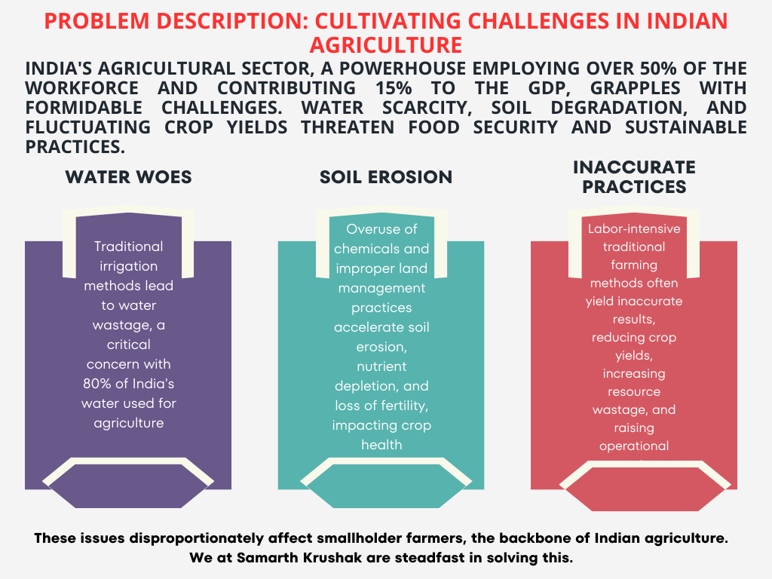
© 2024 Cognizant

Slide 5
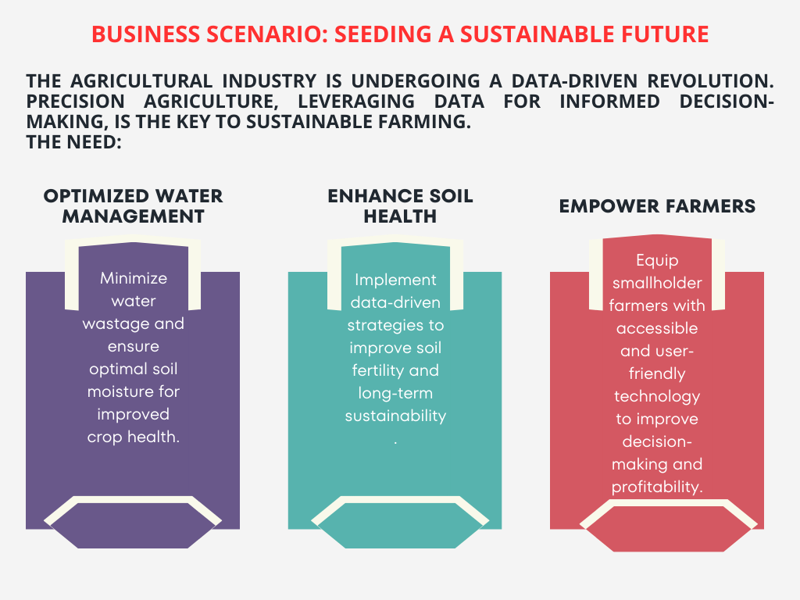
© 2024 Cognizant

Slide 6
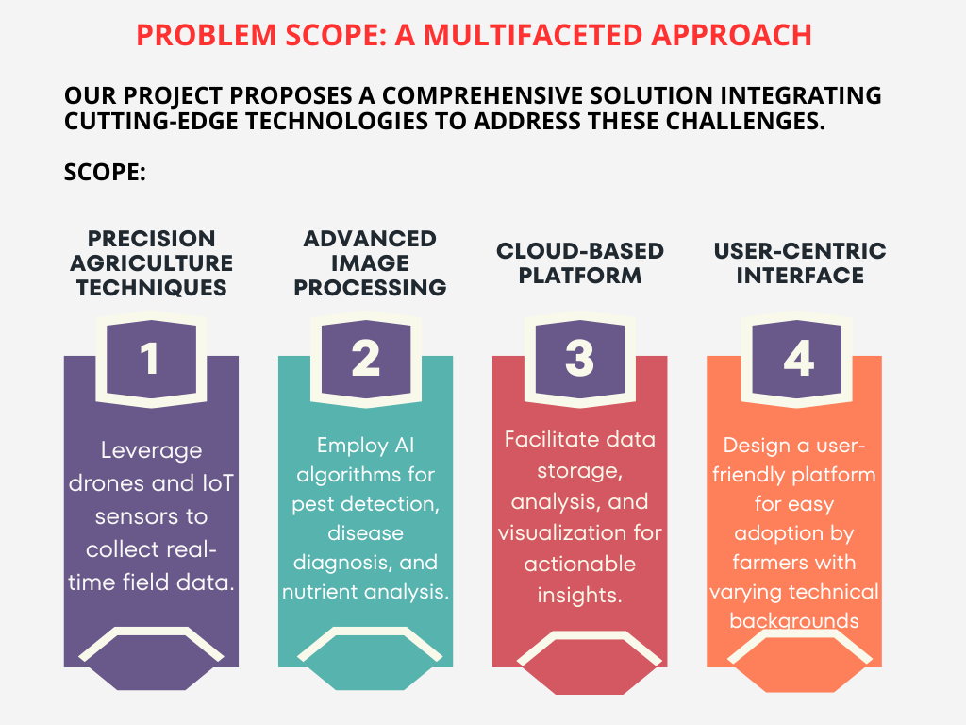
© 2024 Cognizant

Slide 7
Target Users/Stakeholders: Cultivating Success Together
Smallholder Farmers
Gain access to sophisticated tools for informed decision-making, improved yields, and increased profitability
Agricultural Policymakers
The Environment
In other words ALL OF US are stakeholders, because the safer the environment is, the healthier all of us are. Promote water conservation and soil health, ensuring long-term agricultural sustainability
Develop data-driven policies to promote sustainable agricultural practices.
© 2024 Cognizant

Slide 8

IOT
AI
DATA SCAIENCE
SAMARTH KRUSHAK
PROBLEMS
WATER SHORTAGE
SOIL EROSION
PESTS
CLIMATE
SOLUTIONS
OPTIMISED WATER USAGE
ENHANCE SOIL HEALTH
PESTICIDE FREE FARMING
USER FRIENDLY TECH
By harnessing the power of IOT along with AI and data science, our project envisions a future where Indian agriculture thrives, empowered by sustainable practices and technological innovation.

Slide 9
HOW
<idea description> |

Slide 10
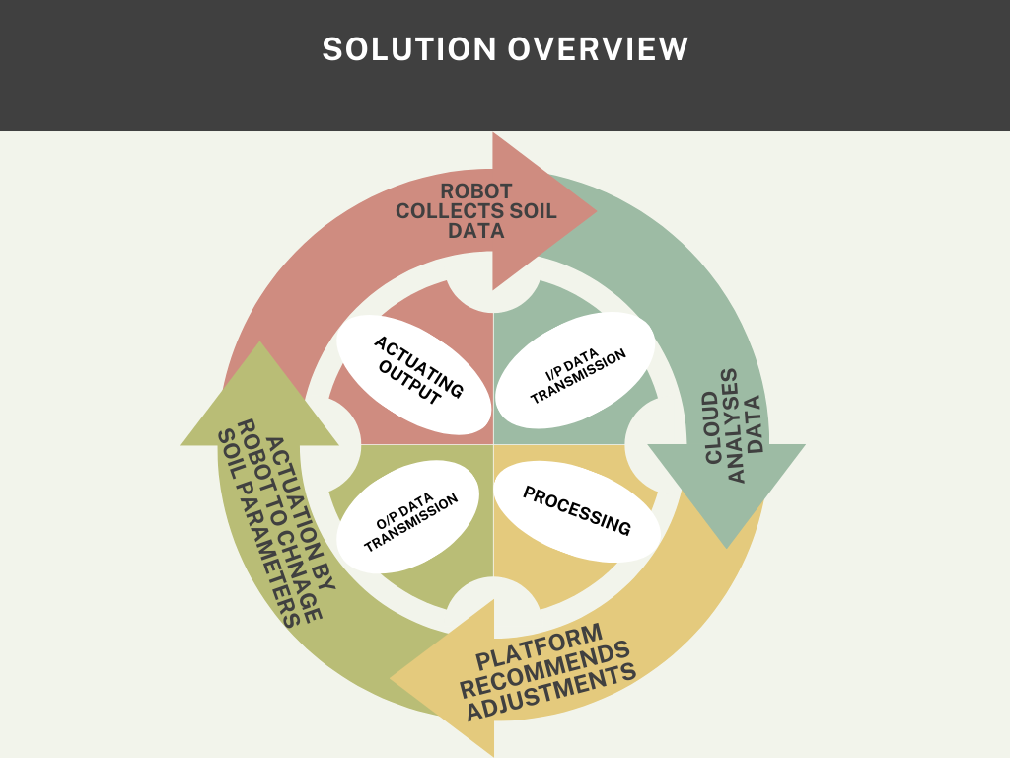
© 2024 Cognizant

Slide 11

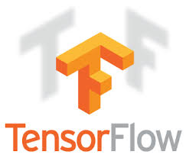


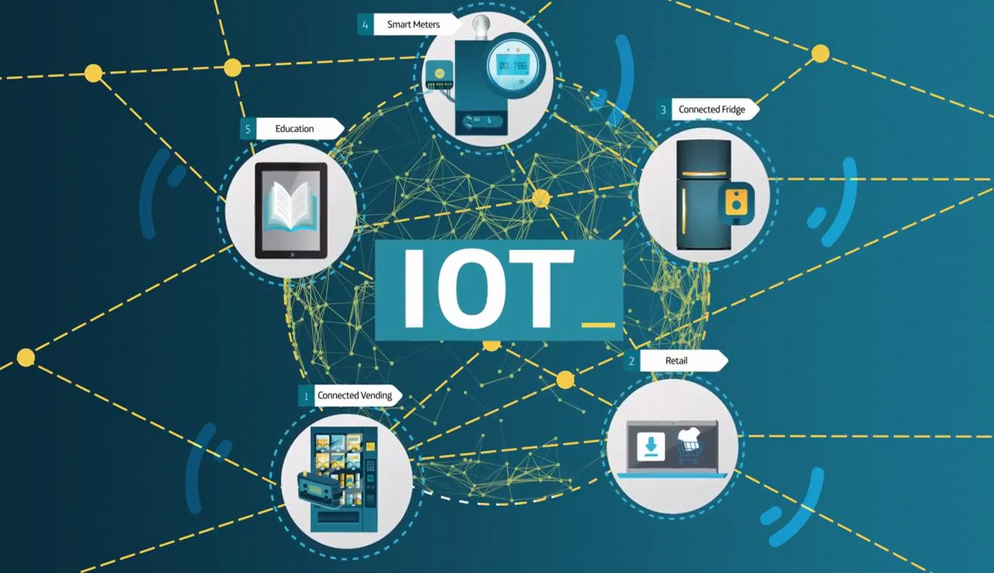
TECHNICAL AIDS-

Slide 12
TECHNICAL DETAILS-
Our project tackles the challenge of optimizing soil management by harnessing a blend of robotics, Internet of Things (IoT) sensors, clever chemistry, and powerful data analysis.
Robot Brains and Brawn:
Platform: We're considering either the tried-and-tested Arduino platform for its affordability and large community, or venturing into the realm of Robot Operating System (ROS) for more complex maneuvers, depending on the project's needs.
Programming Language: C++ is likely our go-to language for robot control. It's known for its muscle when it comes to performance and interacting with hardware.
Sensory Perception:
Sensor Squad: We'll be using sensors to gather real-time intel on soil conditions. Soil moisture sensors, pH sensors, and nitrogen concentration sensors are just a few potential recruits, depending on the specific data we need to analyze.
Speaking the Same Language: I2C, SPI, and UART are the common languages these sensors use to chat with the robot controller. Arduino and ROS libraries can help us translate and understand their messages.
Chemical Cavalry:
The Right Weapon: Speed-treating agents like quicklime or hydrated lime might join the fight against overly wet soil. We'll research the most suitable soldier for our target crops and soil conditions.
Deployment Unit: A reliable dispenser system (think hopper and actuator) needs to be drafted to deliver the chosen agent and integrate seamlessly with the robot.
Talking Tactics: Depending on the chosen communication protocol (I2C, SPI), libraries might be needed for the robot controller to give orders to the dispenser.
© 2024 Cognizant

Slide 13
Data & Processing
Sensor Data: Universal Language (JSON/CSV)
Cloud Connection: Efficient Delivery (MQTT)
Cloud Powerhouse: Storage, Databases & Processing
Accessing the Cloud (SDKs)
Making Sense of the Data
Data Sources:
Sensor data collected by our robots (primary source)
Historical farm data (if available)
External weather data (optional)
Algorithmic Analysis: Identifying Deficiencies & Recommending Actions (using machine learning algorithms like decision trees or regression)
User Interface (UI) - The Farmer's Window
Web or Mobile App? (depending on what best suits farmers' needs)
Building a User-Friendly Interface (using frameworks like ReactJS for web or Flutter for mobile)
Security Shield: Protecting Farm Data Privacy (with secure communication protocols like HTTPS and user authentication)
Integration and Interoperability - The Grand Alliance
Standardized Data Formats (JSON/CSV) for smooth communication with cloud and analysis tools
Open-Source Strength: Leveraging existing code and a vast developer community whenever possible
API Alliance: Seamless Cloud Connection using cloud provider A
© 2024 Cognizant

Slide 14
Why are the technologies you used are appealing for the solution:
IoT Sensors and Robotics: Leveraging IoT sensors and robotics enables real-time data collection and action in the field, allowing for precise and efficient soil management.
Cloud Computing: Utilizing cloud computing for data storage, processing, and analysis provides scalability, accessibility, and flexibility.
Data Analysis and Machine Learning: The use of advanced data analysis techniques and machine learning algorithms enables intelligent soil parameter analysis and precise recommendation generation.
User-friendly Interface: Incorporating user-friendly interfaces using programming languages such as JavaScript/HTML/CSS ensures ease of use and accessibility for farmers
INNOVATION:
Integrated Hardware and Software: Our solution uniquely integrates both hardware (such as IoT sensors and robotics) and software (cloud-based analytics and machine learning algorithms), providing a comprehensive and holistic approach to smart farming.
Dual Functionality - Advisory and Corrective: Unlike traditional smart farming systems that typically offer advisory information only, our system goes a step further by providing both advisory insights and corrective actions. This dual functionality enhances its effectiveness in addressing agricultural challenges.
Enhanced Precision and Accuracy: By combining hardware sensors for real-time data collection with sophisticated software analytics, our solution delivers precise and accurate recommendations for optimizing farming practices. This level of precision is a significant innovation in the field of smart agriculture.
Customized Solutions: Our system has the capability to tailor recommendations and corrective actions based on individual farm conditions and specific crop requirements. This customization ensures that farmers receive actionable insights that are highly relevant to their unique circumstances.
Real-time Monitoring and Intervention: With continuous data collection and analysis, our system enables real-time monitoring of farm conditions and immediate intervention when deviations or anomalies are detected. This proactive approach minimizes risks and maximizes crop yields.
© 2024 Cognizant

Slide 15
MARKET POTENTIAL
Number of Farmers in India: As per the latest agricultural census, India is home to over 146 million operational holdings, with approximately 95 million being small and marginal farmers. These farmers form the primary target market for our precision agriculture solution.
Adoption Rate: Assuming a conservative adoption rate of 10% initially, our solution could potentially be adopted by around 14.6 million farmers in India, presenting a significant initial market.
Revenue Model: Considering a subscription-based revenue model with an average monthly subscription fee per farmer, the potential revenue can be substantial. For instance, if each farmer pays a nominal fee of $10 per month, the potential monthly revenue could reach $146 million at full adoption. Additional revenue could also be generated through one-time hardware sales or service fees for specialized data analysis.
Cost Savings: Precision agriculture offers cost-effective farming by optimizing resource usage and increasing crop yields. If we estimate a 20% reduction in input costs and a 15% increase in productivity, the potential cost savings and additional revenue for farmers can be substantial, significantly impacting the agricultural sector’s profitability.
Scalability: As the solution proves its efficacy, expansion to additional regions and segments of the agricultural value chain can unlock further market potential.
Competitive Landscape: By assessing the competitive landscape and identifying gaps in existing offerings, our solution can be positioned as a superior alternative, attracting more users and increasing market share.
Government Initiatives: Government support, such as subsidies for farm mechanization and digitalization, can further bolster the market potential for our project. For instance, the Indian government’s ‘Digital India’ initiative aims to digitally empower farmers, which could aid in the adoption of our solution.
By combining these factors and conducting thorough market research, we can provide a comprehensive and quantified assessment of the market potential for our precision agriculture project.
© 2024 Cognizant

Slide 16
WHAT
<idea description> |
Value proposition
Improved User Experience​
Increased Efficiency and Time Savings
Cost Savings
Flexibility and Scalability
Social and Environmental Impact

Slide 17
Improved User Experience:
Real-time Data & Actionable Insights: While user experience is subjective, emphasizes the farmer's ability to make informed decisions anytime, anywhere.
Increased Efficiency and Time Savings:
Automated Data Collection and Analysis: Studies show traditional soil testing can take 1-2 weeks [Source: Journal of Soil and Water Conservation]. Our solution can potentially reduce this to real-time data access, saving significant time.
Cost Savings:
Reduced Fertilizer and Water Waste: Purdue University research suggests precise application based on real-time data can lead to 20-30% savings on fertilizer costs [Source: Purdue University]. We can calculate the potential cost savings per hectare per year based on average fertilizer cost and application rates in the given target region.
Improved Crop Yields: The USDA National Agricultural Library reports optimized soil conditions can increase crop yields by 10-15% [Source: USDA National Agricultural Library].
Flexibility and Scalability:
Modular Design: Our solution works on a range of farm sizes and crop types it can accommodate by adjusting robots and sensors.
Social and Environmental Impact:
Sustainable Practices: Studies suggest precision agriculture techniques can reduce water use by 30% [Source: International Commission on Irrigation and Drainage]. The potential water savings of our solution can be achieved based on its functionalities.
Improved Soil Health: Our solution emphasizes optimized soil conditions that contribute to long-term fertility and potentially reduced reliance on future inputs.
© 2024 Cognizant

Slide 18

What does it take & How much does it cost to solve?
R&D: Manage costs (project management tools) and secure funding (grants, partnerships) to develop intellectual property (IP) and prototypes.
Hardware & Software Development: Control costs (agile development, outsourcing) to build functional robot prototypes and a user-friendly interface, leveraging a secure cloud platform.
Field Testing & Validation: Secure funding (pilot projects) and partnerships (farms) to gather real-world data and regulatory approvals.
Pilot Deployment: Gain feedback (limited deployments) and refine the solution to develop a pricing model for commercialization.
Manufacturing & Production: Secure funding (venture capital) and establish a cost-effective manufacturing plan with a reliable supply chain.
R&D: 1-2 Lakh
Hardware & Software: 3-5 Lakh
Cloud Services (Annual): 1-1.5 Lakh
Field Testing: 1-3 Lakh
Pilot Deployment: 1-2 Lakh
Manufacturing & Production: Variable (Depends on production scale)
Total Investment Range: 6-12 Lakh
This may vary due to several factors like market fluctuations, development choices and location & team Size.
© 2024 Cognizant

Slide 19


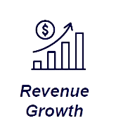
Quantify the benefits & What if I don’t solve?
Potential ROI:
Studies suggest precision agriculture solutions can deliver an ROI of 150-300% within 3-5 years [source: MarketsandMarkets.com, precision agriculture market report].
This high ROI is attributed to the combination of increased yields, reduced input costs, and improved farm efficiency.
This depends on Variable Adoption Rate, Farm Size and Diversity and Market Fluctuations.
Revenue Growth for Solution Provider:
Hardware Sales: Selling the robots and related equipment directly to farmers generates upfront revenue.
Subscription Model: Offering a subscription service for access to the cloud platform, data analysis, and recommendations provides recurring revenue.
Pay-Per-Acre Model: Farmers can pay a fee per acre for the robot to analyze and treat their soil, creating a service-based revenue stream.
By offering a combination of these models, we can cater to different farmer needs and generate significant revenue growth as adoption increases.

Slide 20
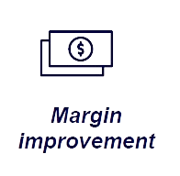
The precision soil management solution has the potential to significantly improve profit margins for farmers by impacting two key areas:
Increased Revenue:
Higher Crop Yields: By optimizing soil conditions for specific crops, the solution can lead to yield increases of 10-30% [source: agtech.folio3.com]. This translates to a direct increase in the amount of crops a farmer can sell.
Reduced Costs:
Precise Nutrient and Water Application: The solution minimizes waste by applying only the necessary fertilizers, pesticides, and irrigation water. Estimates suggest savings of 10-20% on input costs [source: agrivi.com].
What if You Don't Solve?
Here are some potential consequences of not adopting precision soil management solutions:
Stagnant or Declining Crop Yields: Depleted soil nutrients and inefficient resource use can lead to stagnant or even declining crop yields over time.
Increased Production Costs: Without optimization, farmers might overuse fertilizers and water, leading to rising production costs.
Environmental Degradation: Excessive water usage, fertilizer runoff, and soil erosion are potential environmental issues associated with traditional farming practices.
Reduced Farm Profitability: The combined effect of lower yields, higher costs, and potential environmental penalties can reduce farm profitability.
© 2024 Cognizant

Slide 21

Time to realize benefits
R&D (2-3 months): This condensed timeframe prioritizes readily available, open-source solutions for sensors and algorithms. The robot design might be simplified to a manually operated base modified to carry essential sensors.
Hardware & Software (3-6 months): Building a basic robot prototype with essential sensors can be achieved within this timeframe. Developing a lightweight mobile app for data visualization and recommendations should also be achievable in parallel.
Field Testing & Validation (3-4 months): Partnering with local farms for limited testing on a single crop type allows for focused data collection. Manually collecting data during field trials can expedite this phase compared to fully autonomous data collection.
Total Timeline:
Following the aggressive timelines for each phase, the total estimated time to complete the initial development and testing would be:
R&D (2 months) + Hardware & Software (3 months) + Field Testing (3 months) = 8 months
Commercialization (On Hold):
Focus on validating core concept & gathering data first.
Secure additional funding for commercial-scale development later.
Benefits Realization:
Initial benefits for farmers (2-3 years after pilot) are still achievable.
Full ROI and revenue growth timelines may extend due to delayed commercialization.

Slide 22
THANK YOU

